Slide 1

Flavour Fusion- Ingredients to recipe generator
Siddharth kumar-23107044
Sarvesh Deve-231070
Arjun Talekar-231070
Yash Patil-23107007
Project Guide
Ms./Mr.
Veena Trivedi

Slide 2
1. Introduction
• The “Ingredients to Recipe Generator” is to simplify meal preparation by transforming a list of available ingredients into delicious recipes.
• With the rising demand for quick and easy solutions to meal planning, this bridges the gap between culinary creativity and convenience.
Problem Identified : In today’s fast-paced world, individuals often struggle with meal planning and preparation due to time constraints, dietary preferences, and the challenge of using available ingredients efficiently.

Slide 3
Solution: Flavour Fusion provides an intelligent and user-friendly platform that transforms the way individuals discover and prepare meals by addressing these challenges. The solution utilizes smart algorithms to generate personalized recipe suggestions based on the ingredients users already have, thus eliminating the need for lengthy recipe searches.

Slide 4
2. Objectives
To Develop an algorithm that can dynamically generate recipes based on the input ingredients provided by the user.
To Create an interactive and intuitive interface for users to input ingredients and receive recipes.
To Design to accommodate an expanding database of recipes and user inputs efficiently.

Slide 5
3. Scope
Simplifies meal planning by generating recipes based on available ingredients.
Reduces decision-making time for users, especially during busy schedules.
Enhances culinary creativity by exposing users to new dishes and cooking methods.

Slide 6
4. Feature /Functionality
1.Categorized Recipes: Sort recipes by categories such as vegetarian, vegan, non-vegetarian, gluten-free, etc.
2. Recipe Generation: It provides recipes based on the ingredients provided by the user.
3. Adding recipes: Enables users to add their own recipes by their choices.
4. Food Waste Reduction: Encourages efficient use of available ingredients, helping minimize food waste.

Slide 7
5. Outcome of Project
User Can log in
User can search for any dish by its name or by its ingredients
User can also choose categories like vegetarian, non-vegetarian etc
After user search for any specific dish it will give step by step instruction on how to cook the dish

Slide 8
6. Technology Stack
-Python
-MySQL

Slide 9
7. Block Diagram
Flavour Fusion
Admin
User
Register
Sign In
Sign In
Search/Get recipe with available ingredients
Add Recipe
Add his own recipe
Manage Users
Rate or Review the recipe
Find recipes by category
Logout
Logout

Slide 10
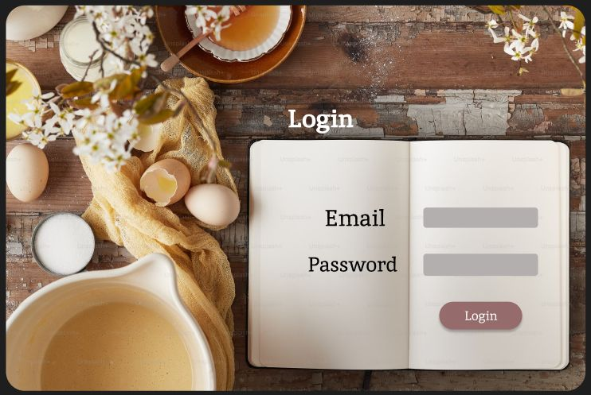
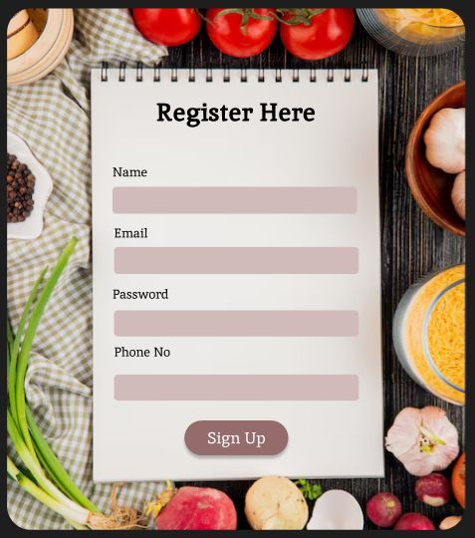

Slide 11
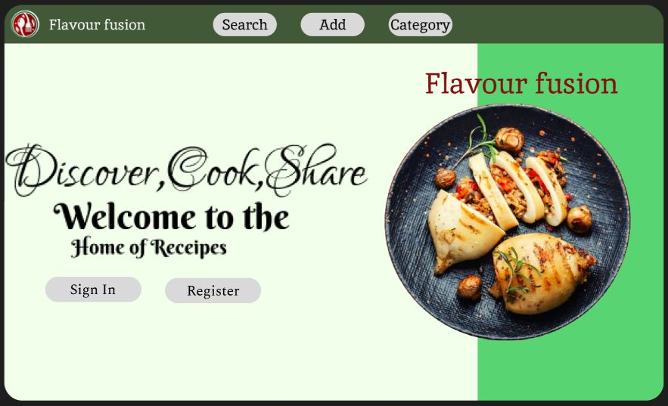
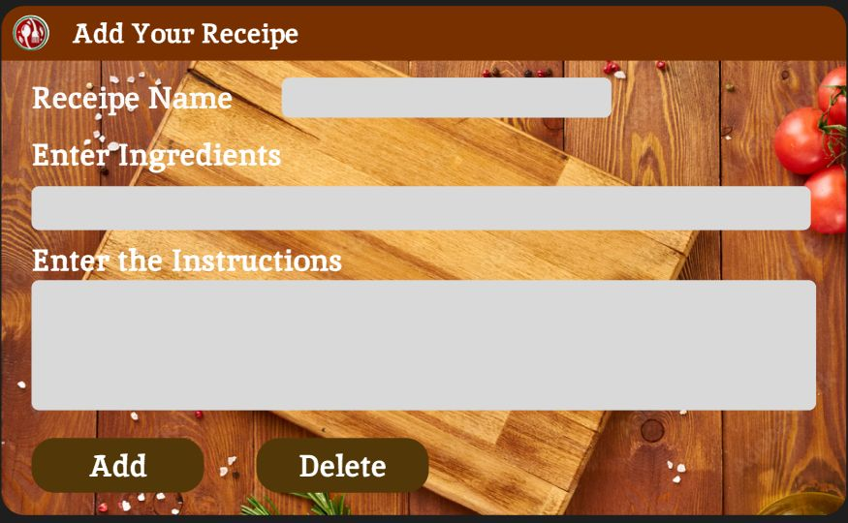

Slide 12
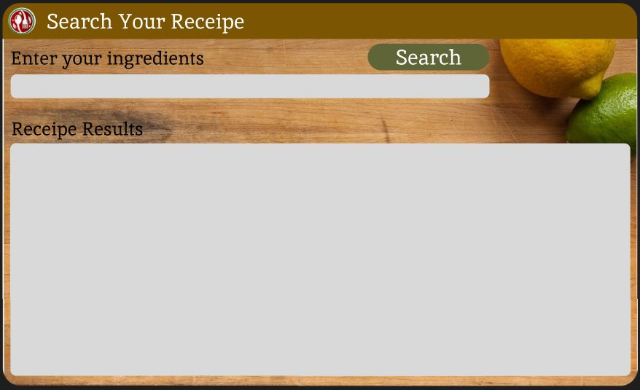
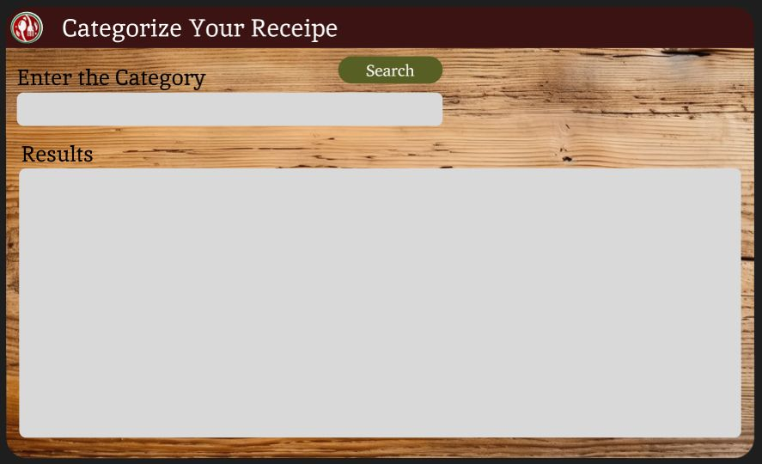

Slide 13
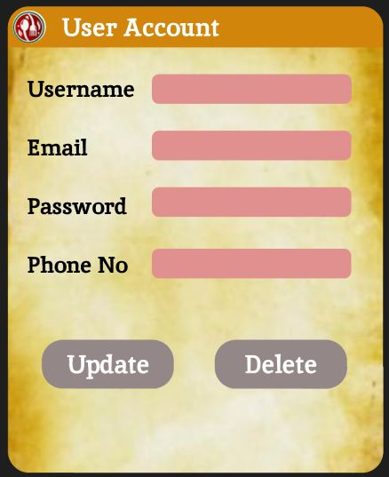
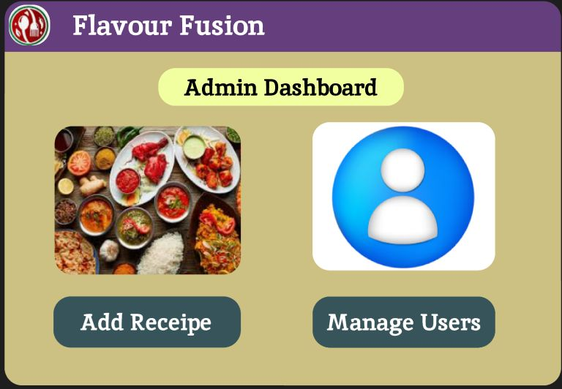

Slide 14
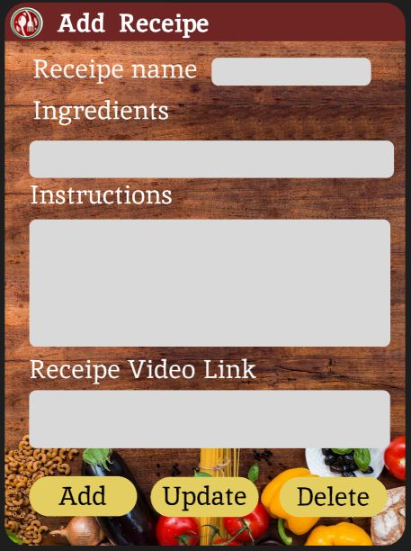
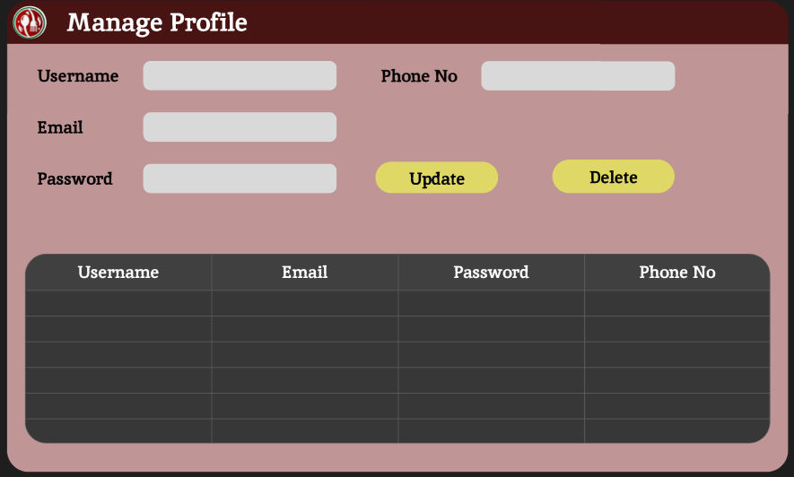

Slide 15
Thank You...!!

